Slide 1
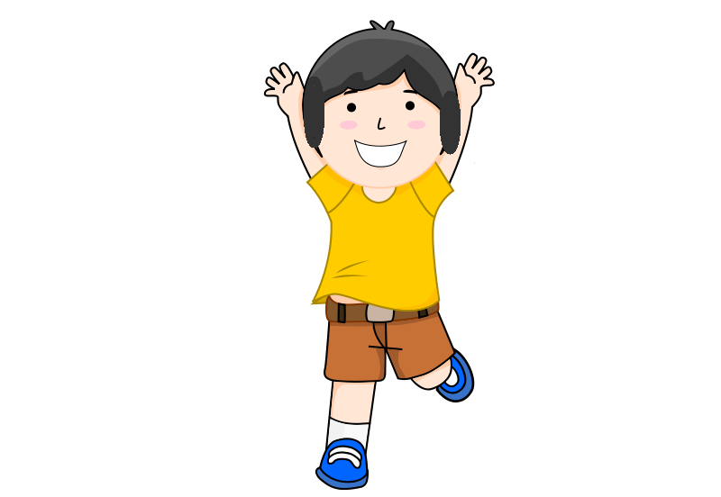
This is Devin.
Notes:
This is Devin.

Slide 2
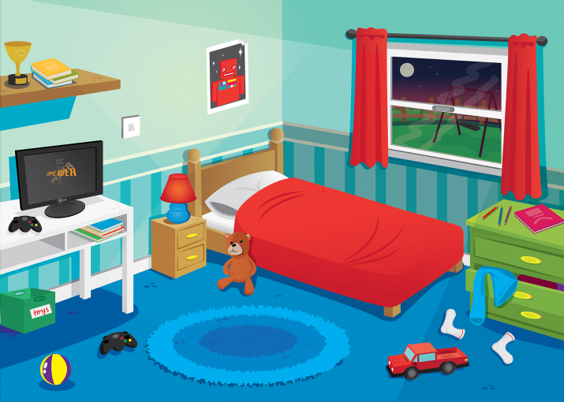
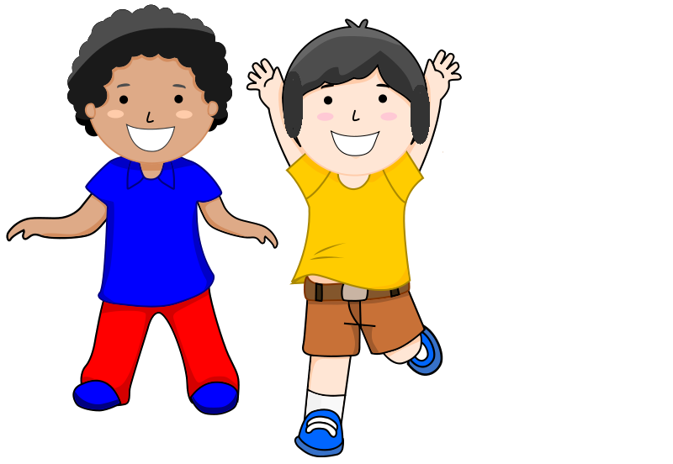
Devin goes to her/his friend Harper's place to sleep over.
Notes:
Devin goes to her/his friend Harper's place to sleep over.

Slide 3
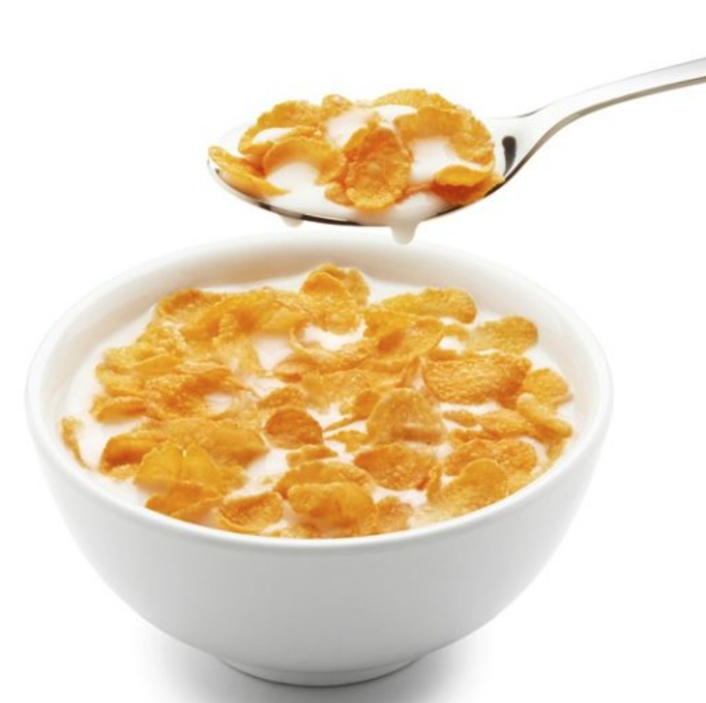
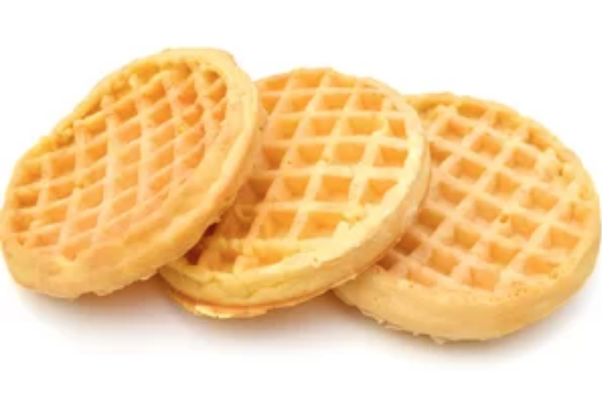
?
← →
Harper and Devin talk about what they will eat for their breakfast in the next morning.-- should they have cereal flakes or toaster waffles?
Notes:
Harper and Devin talk about what they will eat for their breakfast in the morning when they wake up.-- should they have cereal flakes or toaster waffles?

Slide 4
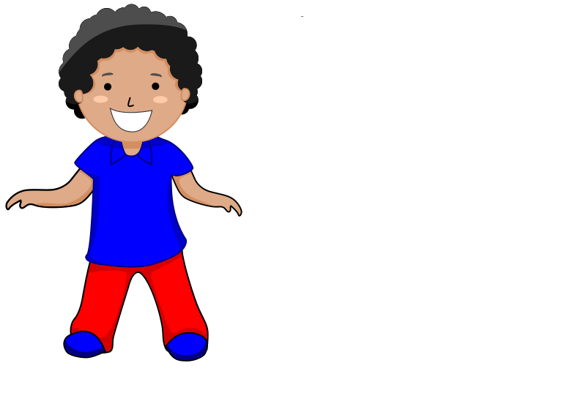
Harper has chosen one of these two things to have for their breakfast and will tell Devin in the next morning!
Notes:
Harper has chosen one of the two things to have for their breakfast and will tell Devin in the next morning!

Slide 5
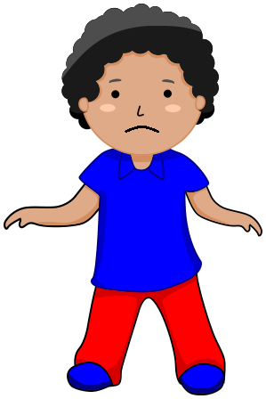

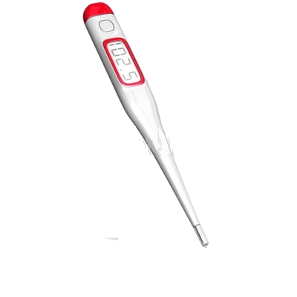
Harper has a fever because (s)he is sick
Notes:
Harper has a fever because (s)he is sick

Slide 6
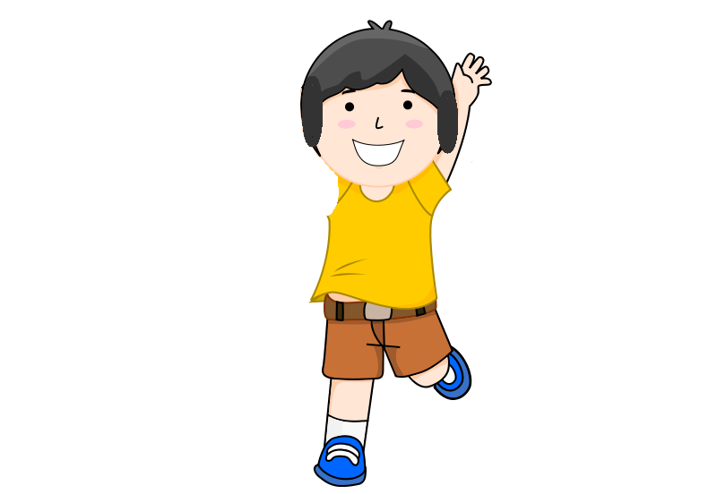
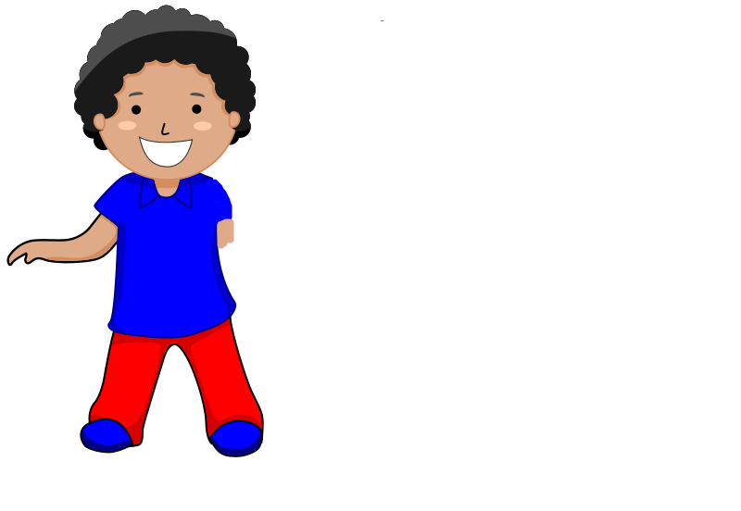
Devin and Harper are so excited about the sleepover. They kiss and hug each other.
Notes:
Devin and Harper are so excited about the sleepover. They kiss and hug each other.

Slide 7



Harper wants to go to sleep early because of her/his fever. S/he and Devin share a sleeping bag at night.
Notes:
Harper wants to go to sleep early because of her fever. She and Devin share a sleeping bag at night.

Slide 8
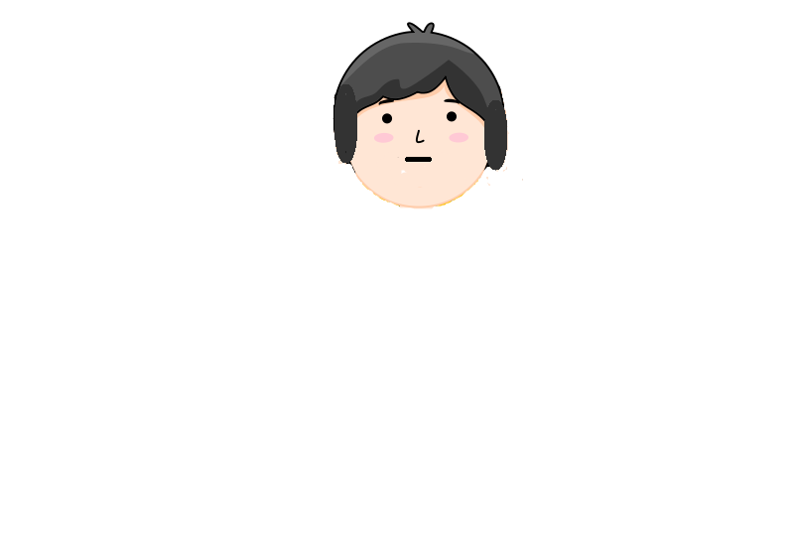
Devin wonders about whether s/he could get a fever from being so close to a person with a fever. S/he thinks about whether s/he will have a fever in the next morning or whether s/he will not have a fever the next morning.
Notes:
Devin wonders about whether s/he could get a fever from being so close to a person with a fever. She thinks about whether s/he will have a fever in the next morning or whether she will not have a fever the next morning.

Slide 9
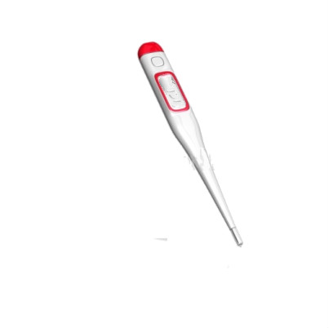
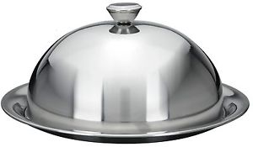
Devin and Harper wake up the next morning. Harper goes to get their breakfast. Devin tests his/her temperature to find out whether he/she has a fever.
Notes:
Devin and Harper wake up the next morning. Harper goes to get their breakfast. Devin tests his/her temperature to find out whether he/she has a fever.

Slide 10


?
←→
?
←→
Here’s where we get to have your help with choosing what to learn about in the story! You can find whether Harper chose cereal flakes or toaster waffles. Or, instead, you can find out whether Devin’s temperature tells her has a fever or does not have a fever. If you want to find out about the breakfast they will have please click this; if you want to find out about Devin’s temperature reading, please click that.
Notes:
[to child] Here’s where we get to have your help with choosing what to learn about in the story! You can find whether Harper chose cereal flakes or toaster waffles. Or, instead, you can find out whether Devin’s temperature tells her has a fever or does not have a fever. If you want to find out about the breakfast they will have please click this; if you want to find out about Devin’s temperature reading, please click that.

Slide 11
Harper chose toaster waffles for their breakfast, and it was yummy!

Slide 12
The end!
They had a great breakfast. By the end of the day everyone felt better too. They are such great friends.
Notes:
They had a great breakfast. By the end of the day everyone felt better too. They are such great friends

Slide 13

Devin did get a fever!
Devin got a fever in the morning.
Notes:
Devin got a fever in the morning.

